Slide 1
Shaping Resilient Rural Community
in Myanmar
Zarni Minn, Ph.D
Department of Rural Development
Ministry of Agriculture, Livestock and Irrigation

Slide 2
What is Resilience

Slide 3
Engineering – degree to which a structure like a building or a bridge can return to a baseline state after being disturbed.
Emergency response – speed with which critical system can be restored after a disaster.
Ecology – ecosystem’s ability to keep from being irrevocably degraded.
Psychology – capacity of an individual to deal effectively with trauma.
Business – putting in place backup of resources to ensure operation in the face of disaster.
keywords
continuity
Recovery
Ability

Slide 4
Resilience
The ability of a system, community or society to resist, absorb, cope with and recover from the effects of hazards and to adapt to longer term changes in a timely and efficient manner without undermining food security or wellbeing.
The capacity to endure shocks and stresses and bounce back.
Covers people, communities, systems, infrastructure.
Notes:
There are many different definitions of resilience, but mostly it refers to the ability to ‘bounce back’ after some stress or crisis. Thus resilience can be applied to people, to communities, to households, to systems, and to infrastructure.

Slide 5
Living with Risk: a Disaster
Decreased capabilities of community
Increased demands from community

Slide 6
To improve community resilience is to enhance their ability
Stability
the ability to withstand shocks or disasters
Responsiveness
Adaptive capacity
the ability to recover after sustaining losses from a shock or disaster
the ability to learn and change behavior or increasing future ability

Slide 7
Why is Resilience Important

Slide 8
Risk Profile
Oneof the most vulnerable countries in the world to effects of Climate Change
Drought, cyclone, earthquake intense rain, strong surge, flood landslide, extreme high temperature
Livelihood and well-being of people in delta and dry zone is highly sensitive and vulnerable

Slide 9
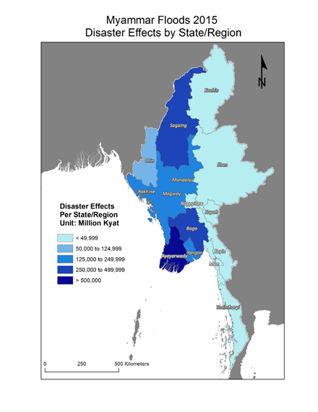
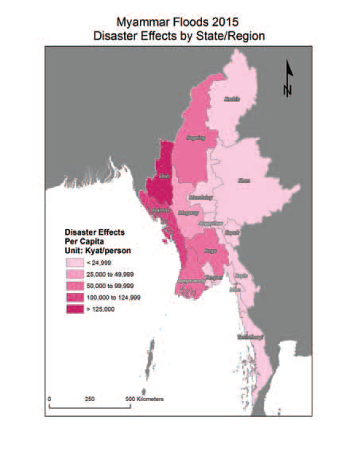
2015 Disaster Effects

Slide 10
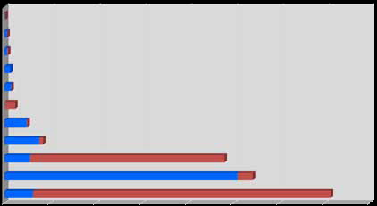
2015 Disaster Effects
Communication
Electricity
Health
Water resource
WASH
Disaster Risk
Education
Transport
Industry & commerce
Housing
Agri, livestock, fishery
25 %
28 %
37 %
MMK million
Damage |  |  | Losses |  |  | Disaster Effect
Public | Private | Total | Public | Private | Total | Public | Private | Total
165,669 | 626,823 | 792493 | 29267 | 1120253 | 1149521 | 194937 | 1747077 | 1942014

Slide 11
Projected Temperature Increase: Dry Zone
3,5
3
2,5
2
1,5
1
0,5
0
Degree Increase (°C)
2020
2050
2020 2050
Hot Season (Feb-May)
2020 2050
Wet Season (Jun-Oct)
2020 2050
Cold Season (Nov-Jan)
Annual
Low Estimate High Estimate

Slide 12
Projected Temperature Increase: Delta
3
2,5
2
1,5
1
0,5
0
Degree Increase (°C)
2020s 2050s
Annual
2020s 2050s
Hot Season (Feb-May)
2020s 2050s
Wet Season (June-Oct)
2020s 2050s
Cold Season (Nov-Jan)
Low Estimate
High Estimate

Slide 13
Increase in Hot Days by Mid-century
Higher average temperatures cause big changes in extreme heat
In the past, the single hottest day in a typical April was about
38ºC
By mid-century, this temperature will happen 4-17 times in a typical April

Slide 14
Rainy season is getting shorter
Dur•Uon of monsoon srason
- - - 5 Year running average
200
180
 | 1971(179 days) | '
 | NORJ\IIAL = 144 DAYS 1997(103 dnys) RELATIVELY SHOUTJ4:R
:
160
c
.⁰:
j
14o
120
JOO
80
1950
l95S
1960 l96S 1970 197S 1980 1985 1990 1995
2000
2005
-YEARS
Flg(J) Map showing the duration of monsoon season of Myanmar
· During1955·2800
Tun Lwin- 2002

Slide 15
Historical Rainfall Trends
=>
More rain
Shorter Rainy
Season
More Heavy Rain
(Less useful, more damaging)

Slide 16
Resilience for Rural Development
Rural development is key to overall poverty reduction
Resilience is key to reducing poverty by:
(1) Protecting livelihoods
(2) Promoting sustainability and diversity
(3) Providing a platform for long-term development
Adaptive capacity cannot simply be imposed from above – must be nurtured in the social structures.
Notes:
Resilience is a very important concept for rural development, because, firstly, rural development is a key step to overall poverty reduction. Resilience is important for reducing poverty, by protecting livelihoods-from natural disasters and shocks; by promoting more sustainable livelihoods which can adapt and change in a changing economy; and providing a platform for long-term development by enabling households and communities to invest more in long-term things such as education, nutrition and community infrastructure.

Slide 17
What Should We Do

Slide 18
DRD’s Initiatives on Resilience
DRR & climate change is cross-cutting issues
Community Driven Development Project - ~ 70 townships
Village Revolving Fund Project – 7,783 villages
Village Development Fund Project - ~ 6,000 villages
Information Resource Center Project –8 centers (upper Myanmar)
Gov.- funded project- Building disaster resilient infrastructure at disaster prone areas.
Notes:
There are many different definitions of resilience, but mostly it refers to the ability to ‘bounce back’ after some stress or crisis. Thus resilience can be applied to people, to communities, to households, to systems, and to infrastructure.

Slide 19
Research: Evidence-based Policy Making
In cooperation with DRD, SPPRG, Eco. Dev.
Poverty and Vulnerability Survey (2015) - 22,000 households across the country.
Assessment on Evergreen Village Development Project (2015-2016) -10,300 households across the country.
Notes:
In the past 2 years, DRD has undertaken two major research projects on rural development. The first one was a survey of 22,000 households in rural areas in all States and Regions, focusing on poverty and vulnerability. The second was a case-control study of Mya Sein Yaung village project areas, covering 10,000 households, These were undertaken together with SPPRG and EcoDev. The main findings presented today are based on analysis of data from tehse two studies.

Slide 20
Influential Factors on Resilience
Remoteness
Remote status | Resilience | % low resilience
Urban | 2.17 | 15.7%
Peri-urban | 2.00 | 20%
Semi-Rural | 2.03 | 20%
Rural | 2.08 | 19%
Remote rural | 2.07 | 19.6%
Most remote | 1.99 | 17%
Total | 2.04 | 19%
Remote communities have low resilience but peri-urban too.
Although remote status is linked to resilience, it is more complex.
Notes:
Firstly, what factors influence resilience in rural communities? When we consider issues like remote access, we can see that although the most rural communities have the lowest resilience, there is also lower resilience in villages which are close to towns, in what are called peri-urban areas. Here, remoteness is measured by three things: distance, time taken to travel and cost to travel to nearest town. This suggests that although remote status is linked to resilience, it is more complex.

Slide 21
Influential Factors on Resilience
2. Infrastructure
Infrastructure Type | Influence on Resilience
Road | +
Water/irrigation | ++
Electricity | N
School | N
Clinic | N
The availability of community infrastructure is associated with resilience, particularly roads and water supply & irrigation.
Notes:
Firstly, what factors influence resilience in rural communities? When we consider issues like remote access, we can see that although the most rural communities have the lowest resilience, there is also lower resilience in villages which are close to towns, in what are called peri-urban areas. Here, remoteness is measured by three things: distance, time taken to travel and cost to travel to nearest town. This suggests that although remote status is linked to resilience, it is more complex.

Slide 22
Influential Factors on Resilience
3. Economy
Factor | Influence on resilience
Poverty level of State/region | +++
Unemployment level (all) | N
Unemployment level (youth) | ++
Inequality | +++
Local economy has a significant association with resilience; resilience rates are lower in States & Regions with higher rates of poverty, and inequality
Notes:
Firstly, what factors influence resilience in rural communities? When we consider issues like remote access, we can see that although the most rural communities have the lowest resilience, there is also lower resilience in villages which are close to towns, in what are called peri-urban areas. Here, remoteness is measured by three things: distance, time taken to travel and cost to travel to nearest town. This suggests that although remote status is linked to resilience, it is more complex.

Slide 23
Key Issues to Build Resilience
1. Diversity (Livelihood)
 | Resilience | % low resilience
Agriculture only | 2.20 | 16.7%
Fishing Only | 1.94 | 21%
Livestock only | 2.12 | 16.8%
Agriculture + livestock | 2.12 | 17.8%
Fishing + livestock | 2.03 | 18.8%
Overall: Just increased livelihood diversity is not directly associated with greater resilience. The highest levels of resilience are found in households with a stable agricultural base.
Notes:
Firstly, what factors influence resilience in rural communities? When we consider issues like remote access, we can see that although the most rural communities have the lowest resilience, there is also lower resilience in villages which are close to towns, in what are called peri-urban areas. Here, remoteness is measured by three things: distance, time taken to travel and cost to travel to nearest town. This suggests that although remote status is linked to resilience, it is more complex.

Slide 24
Key Issues to Build Resilience
1. Diversity (Income)
Sources | Resilience | % Low resilient
1 | 1.7 | 24.8%
2 | 2.0 | 21.3%
3 | 2.1 | 16.6%
4 | 2.1 | 16.8%
5 | 2.1 | 14.0%
6 | 2.1 | 7.1%
Total | 2.0 | 18.9%
Amongst households with daily wage as a significant income source, income diversity is strongly linked to resilience
Notes:
Firstly, what factors influence resilience in rural communities? When we consider issues like remote access, we can see that although the most rural communities have the lowest resilience, there is also lower resilience in villages which are close to towns, in what are called peri-urban areas. Here, remoteness is measured by three things: distance, time taken to travel and cost to travel to nearest town. This suggests that although remote status is linked to resilience, it is more complex.

Slide 25
Key Issues to Build Resilience
1. Diversity (Income)
Sources | Resilience | % Low resilient
1 | 1.77 | 25.3%
2 | 1.90 | 22.3%
3+ | 1.95 | 21.0%
Among female headed households, income diversity is strongly linked to resilience.
Livelihood diversification is an appropriate strategy for increasing resilience when targeted to economically vulnerable households.
Notes:
Firstly, what factors influence resilience in rural communities? When we consider issues like remote access, we can see that although the most rural communities have the lowest resilience, there is also lower resilience in villages which are close to towns, in what are called peri-urban areas. Here, remoteness is measured by three things: distance, time taken to travel and cost to travel to nearest town. This suggests that although remote status is linked to resilience, it is more complex.

Slide 26
Key Issues to Build Resilience
2. Access to Finance
Finance Provider | Positive association with increased resilience for all households | Positive association with increased resilience for poor households
Private moneylender | - | -
Agricultural loan | ++ | -
Mya Sein Yaung | - | +++
Co-operatives | +++ | -
NGO | - | -
Increased access to finance is associated with increased resilience-but impact depends on source.
MSY associates with poor but other loans associate with less poor.
Notes:
Firstly, what factors influence resilience in rural communities? When we consider issues like remote access, we can see that although the most rural communities have the lowest resilience, there is also lower resilience in villages which are close to towns, in what are called peri-urban areas. Here, remoteness is measured by three things: distance, time taken to travel and cost to travel to nearest town. This suggests that although remote status is linked to resilience, it is more complex.

Slide 27
Key Issues to Build Resilience
3. Increased Income & Livelihood Investment
Direct link between income and resilience
Direct link between income and investment in livelihoods
Investment in livelihoods linked to longer-term resilience
Increasing rural incomes is achieved through diversification, increasing the effectiveness of livelihoods, and also stronger market linkages.
Notes:
In the past 2 years, DRD has undertaken two major research projects on rural development. The first one was a survey of 22,000 households in rural areas in all States and Regions, focusing on poverty and vulnerability. The second was a case-control study of Mya Sein Yaung village project areas, covering 10,000 households, These were undertaken together with SPPRG and EcoDev. The main findings presented today are based on analysis of data from tehse two studies.

Slide 28
Other Consideration
Resilience is wide-ranging issue & it cannot be achieved only by focusing on livelihoods;
Integrated risk management focusing on social protection, disaster risk reduction, links to efforts on climate change and natural resource management.
This requires a multi-disciplinary & inter-ministerial approach.
Notes:
In the past 2 years, DRD has undertaken two major research projects on rural development. The first one was a survey of 22,000 households in rural areas in all States and Regions, focusing on poverty and vulnerability. The second was a case-control study of Mya Sein Yaung village project areas, covering 10,000 households, These were undertaken together with SPPRG and EcoDev. The main findings presented today are based on analysis of data from tehse two studies.

Slide 29
Other Consideration
Risk Transfer
Disaster risks are growing but 65 % of risk can be averted.
Combined risk prevention, risk mitigation, risk transfer
Macro
Government (infrastructure)
Meso
Group/Cooperative (business)
Micro
Household (business)
Reinsurance
Insurance
Notes:
In the past 2 years, DRD has undertaken two major research projects on rural development. The first one was a survey of 22,000 households in rural areas in all States and Regions, focusing on poverty and vulnerability. The second was a case-control study of Mya Sein Yaung village project areas, covering 10,000 households, These were undertaken together with SPPRG and EcoDev. The main findings presented today are based on analysis of data from tehse two studies.

Slide 30
Recommendation
Livelihood diversification should be extended for increasing resilience in economically vulnerable households.
To increase access to finance to different target groups.
Inter-agency collaboration for building resilience in rural communities.
Innovative way to enhance community resilience like risk transfer solution.
Multi-disciplinary research to study effective ways to build resilience.
Notes:
In the past 2 years, DRD has undertaken two major research projects on rural development. The first one was a survey of 22,000 households in rural areas in all States and Regions, focusing on poverty and vulnerability. The second was a case-control study of Mya Sein Yaung village project areas, covering 10,000 households, These were undertaken together with SPPRG and EcoDev. The main findings presented today are based on analysis of data from tehse two studies.

Slide 31
Thank You
Zarni Minn, Ph.D
Department of Rural Development
minnzarni@gmail.com
+ 95 9 440935588
+ 95 67 409415

